Slide 1
New Workbook
File created on: 7/29/2021 1:48:43 AM

Slide 2
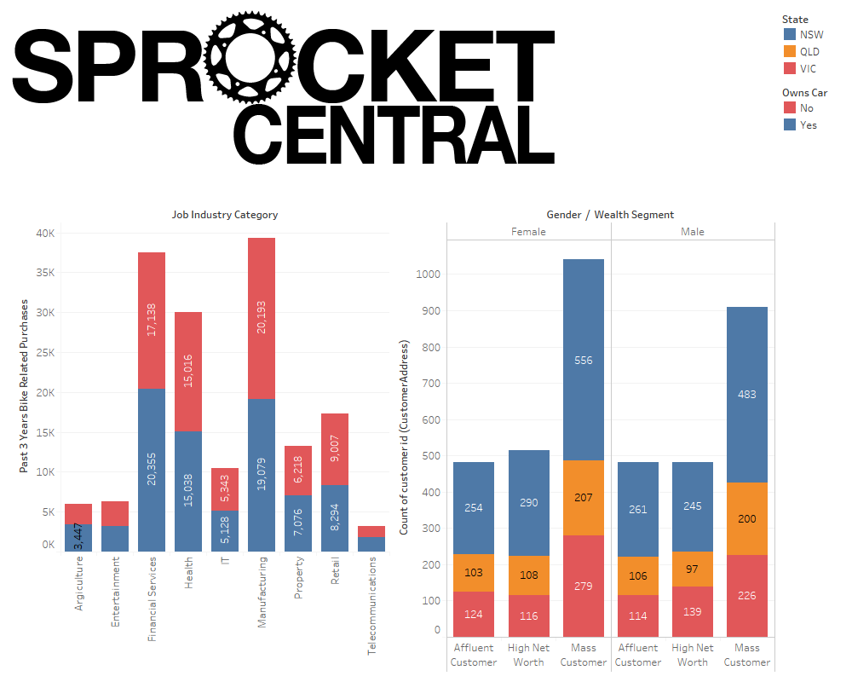

Slide 3
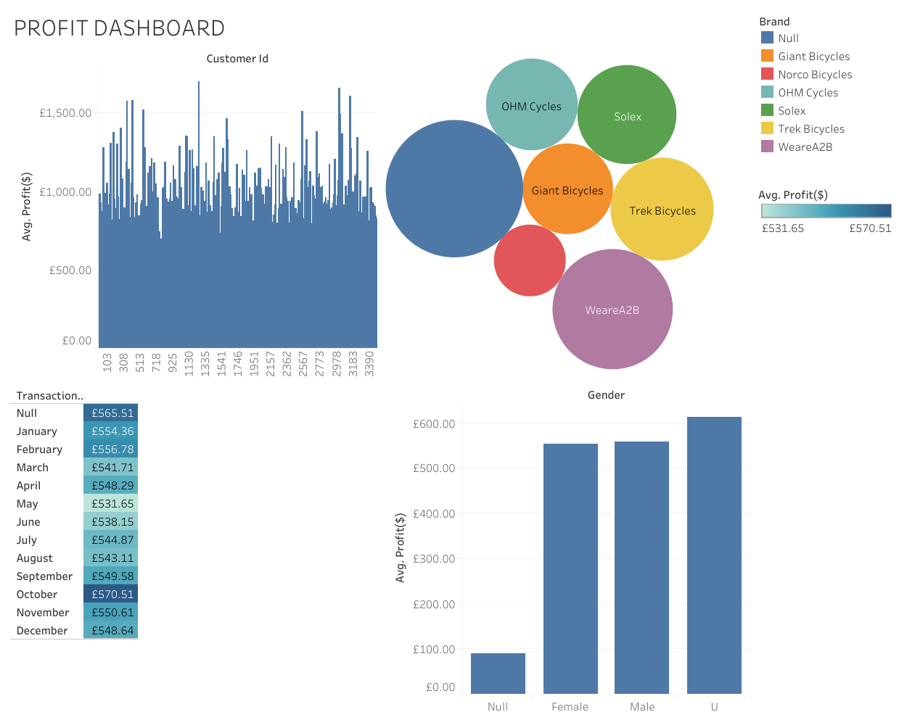

Slide 4
